Slide 1
Performance tips and tricks for Qt/QML Application
Content
General
App Start
Image
List
Other

Slide 2
General
Do not use JavaScript, but rather implement the UI with QML and the engine with C++
JavaScript should be avoided as much as possible. Do not use it at all.
JavaScript code should be kept to a minimum. C++ should be used to implement application's the business logic.
JavaScript is especially bad for performance when it is run during animation, e.g. in lists.
If you must use JavaScript anyway, simplify your JavaScript expressions as much as possible.
It is also recommended to set values for properties using QML property binding than JavaScript value assignment.
Example:
Wrong:
Text {
text: {
if (titleItem === titleItem1) {
return "This is hunght";
}
return "hunghoang"
} anchors.centerIn: parent
}
Right:
text: (titleItem === titleItem1) ? "This is hunght" : "hunghoang"

Slide 3
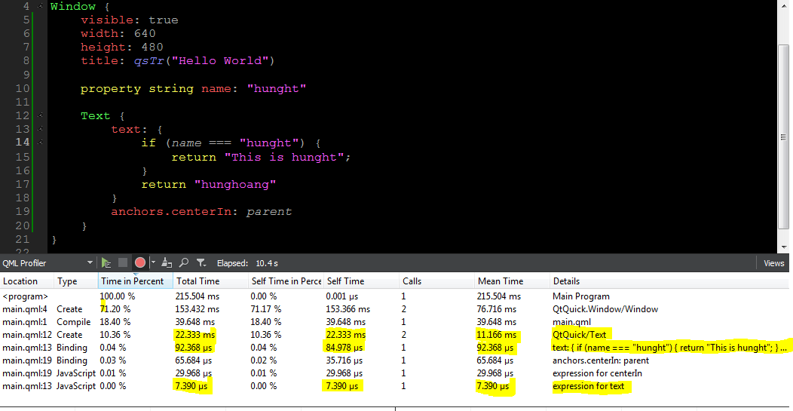
Compare result
Wrong way

Slide 4
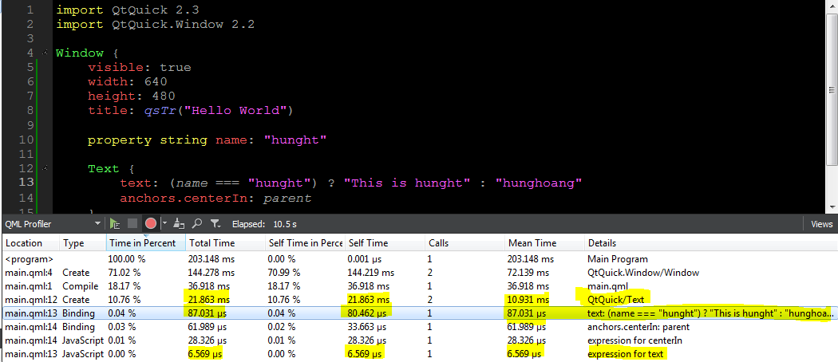
Compare result
Right way

Slide 5
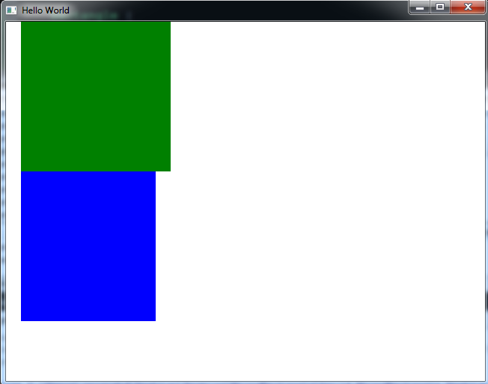
Use anchors rather than bindings to position items relative to each other
Wrong way to bind 2 rectangle:
Rectangle {
id: rect1
x: 20
width: 200;
height: 200
color: “green”
}
Rectangle {
id: rect2
x: rect1.x
y: rect1.y + rect1.height
width: rect1.width - 20
height: 200
color: “blue”
}

Slide 6
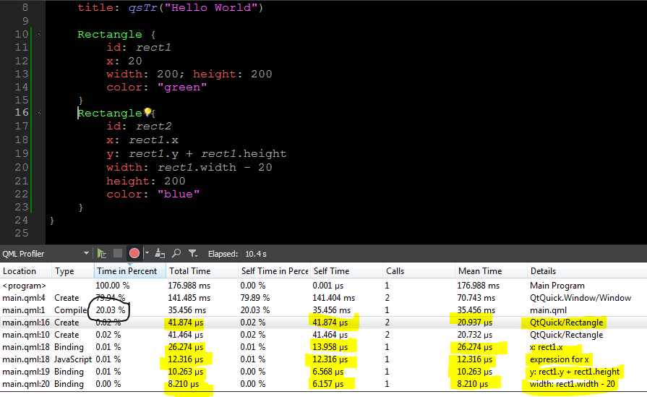
Result:
Wrong way: 20,03%

Slide 7
Use anchors rather than bindings to position items relative to each other
Rectangle {
id: rect1
x: 20
width: 200;
height: 200
color: "green"
}
Rectangle {
id: rect2
height: 200
anchors.left: rect1.left
anchors.top: rect1.bottom
anchors.right: rect1.right
anchors.rightMargin: 20
color: "blue"
}

Slide 8
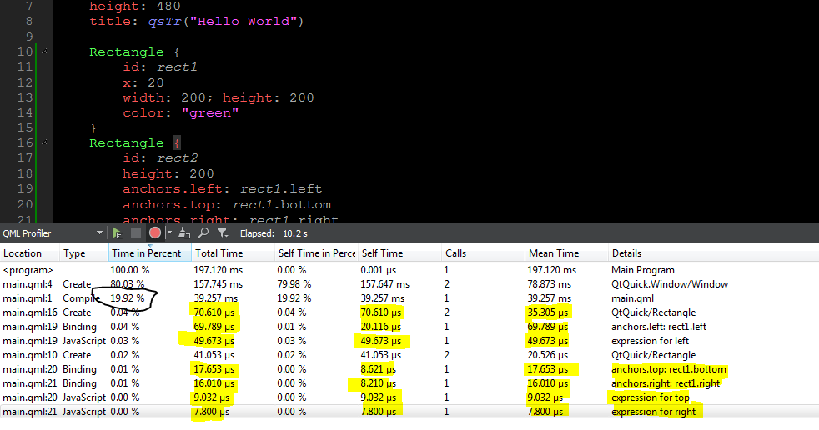
Result:
Right way: 19,92%

Slide 9
App Start
Use loaders to dynamically load/unload QML
QML application starts quite slow if the whole application is implemented in one huge QML file
Should partition your application into logical entities, load minimum QML at start and load more as you need it using Loader
The Loader item can be used to dynamically load and unload visual QML components defined in a QML file or items/components defined within a QML file
When partition your application into serveral QML file, so this way loading and unloading are easier to control. DO NOT HAVE ONE HUGE QML FILE PER APPLICATION.
Load minimum amount of QML file at application start to make your application can start quickly as possible. After that, you can connect network, show spinner,...If your first view is very complex and requires lots of QML to be loaded, show a splash screen or something,...
Creating a dialog can take more than 100ms of time. Make sure you use Loader to load the dialog

Slide 10
Example use Loader in QML
Wrong way:
MouseArea {
anchors.fill: parent
onClicked: {
rect.visible = true
}
}
Rectangle {
id: rect
width: 300 ;height: 300
visible: false
Text { text: "hunght abcd" y: 0 }
Text { text: "hunght abcd" y: 20 }
Text { text: "hunght abcd" y: 40 }
........................
Text{ text: "hunght abcd" y: 200 } }

Slide 11
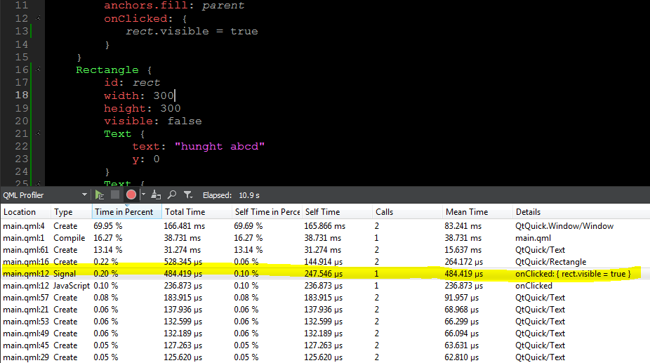
Result:

Slide 12
Right Way
MouseArea {
anchors.fill: parent
onClicked: {
loader.source = "qrc:/LoaderItem.qml"
}
}
Loader {
id: loader
source: ""
}

Slide 13
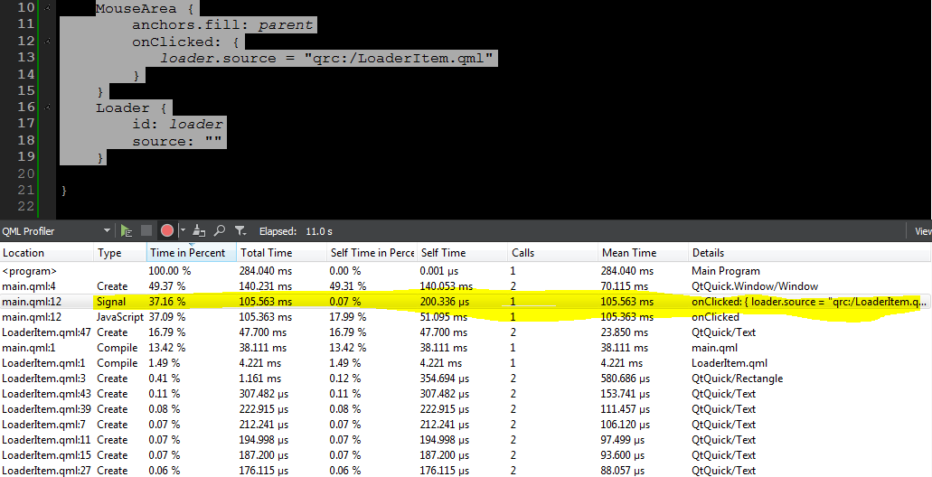
Result: Right Way

Slide 14
Image
Bitmap formats vs. vector graphics formats
Load large images asynchronously
Avoid resizing/scaling
Use sourceSize with large images
Enable Image.smooth only when necessary
Avoid composing an image from a number of elements

Slide 15
List
Ensure that your data model is as fast as possible
CacheBuffer usage in ListView/GridView

Slide 16
Other
Fixed length lists with Flickable+Column+Repeater
Beware of string operations
Animate as small area of the screen as possible in transition animations
Avoid complex clipping
Does it help performance if you strip off comments or white space from QML files?
Avoid unnecessary conversion
Anchors and memory consumption

Slide 17
Qt C++
Controlling QObject Ownership
Turn off sample buffers
Integrating with a QWidget-based UI
Integrating QML with a QGraphicsView-based UI
Use showFullScreen()
Avoid unnecessary QRegExp construction
Creating QServiceManager instance is costly during application startup
Reduce expense of Qt::SmoothTranformation without reducing image quality
Avoid duplicating containers by accident
Avoid implicit copies caused by operator[]
Avoid connecting to QGraphicsScene ::changed() signal

